Slide 1
Immutable.js

Slide 2
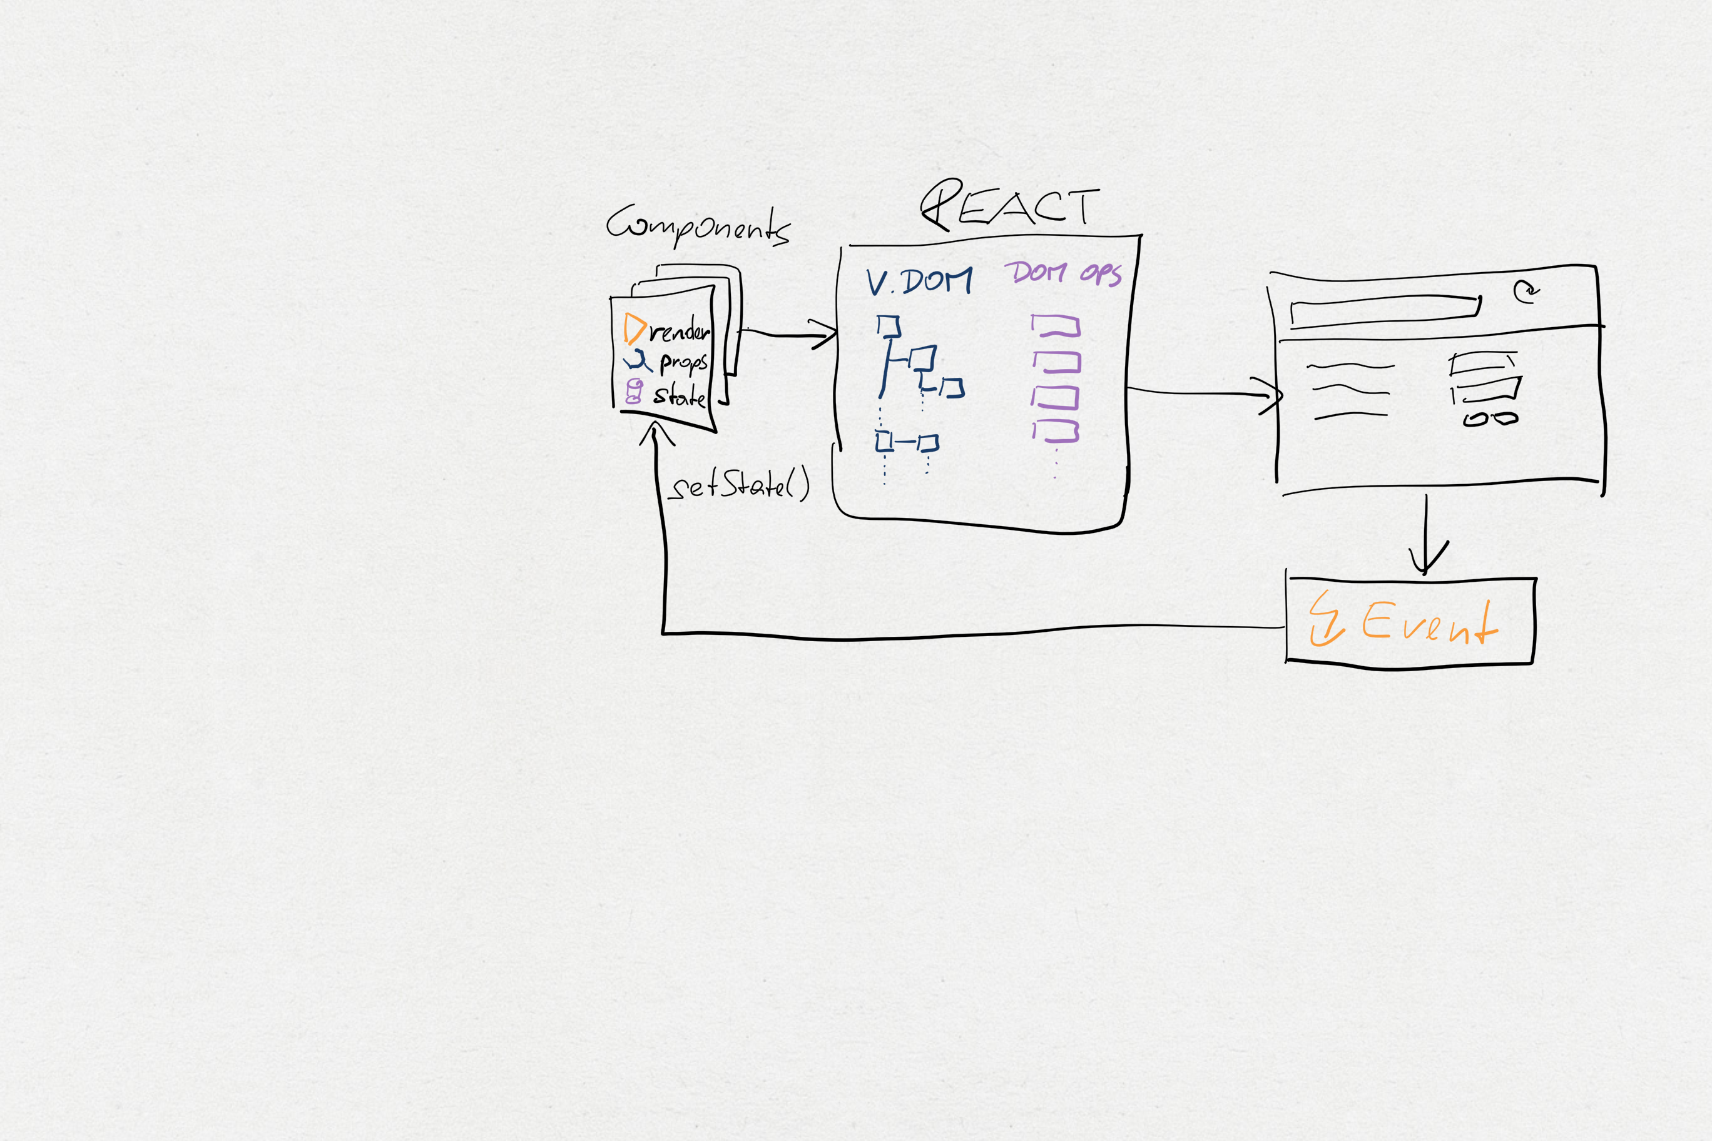

Slide 3
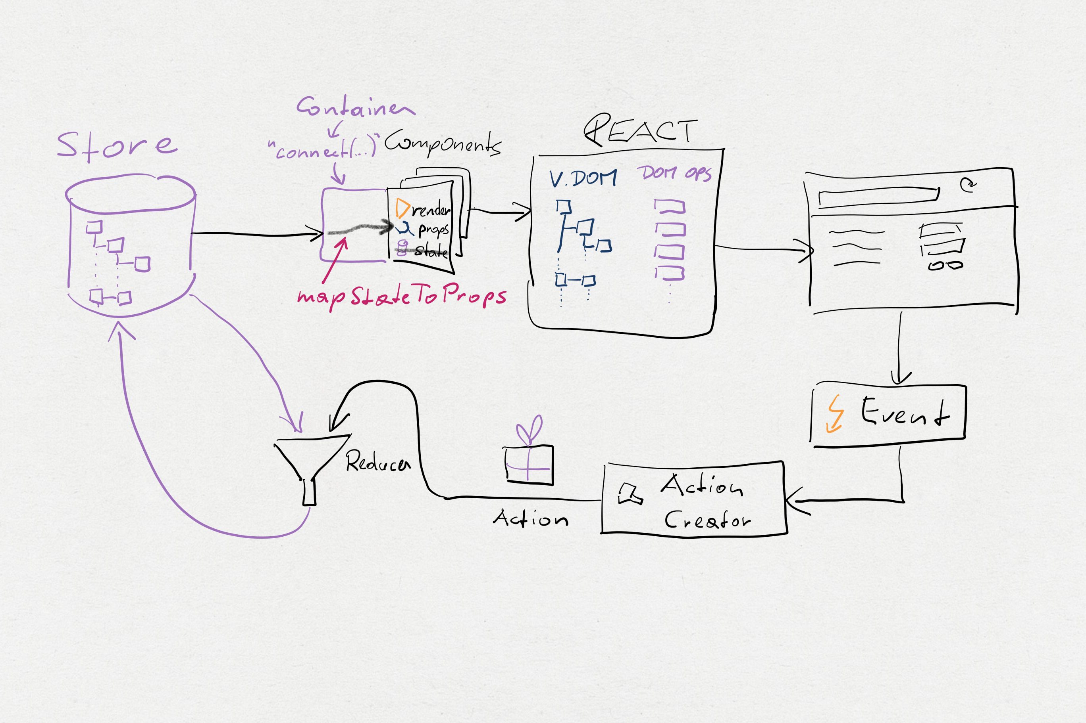

Slide 4
Immutable

Slide 5
Flow (Types)

Slide 6
Slides, Code
https://github.com/dtanzer/talk-redux-immutable

Slide 7

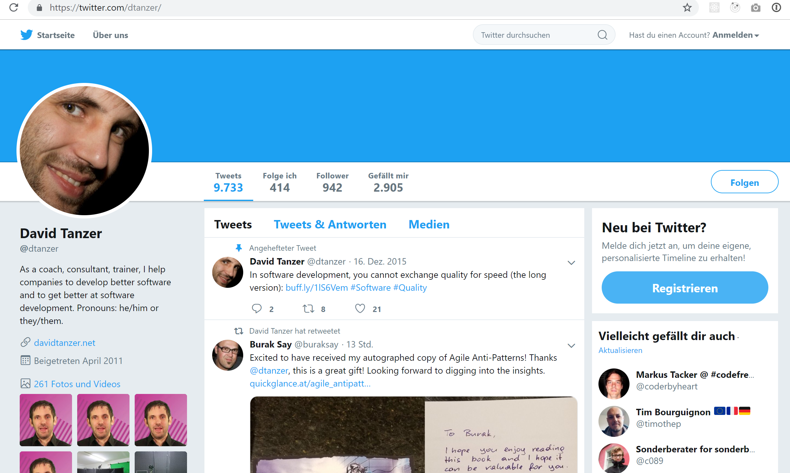
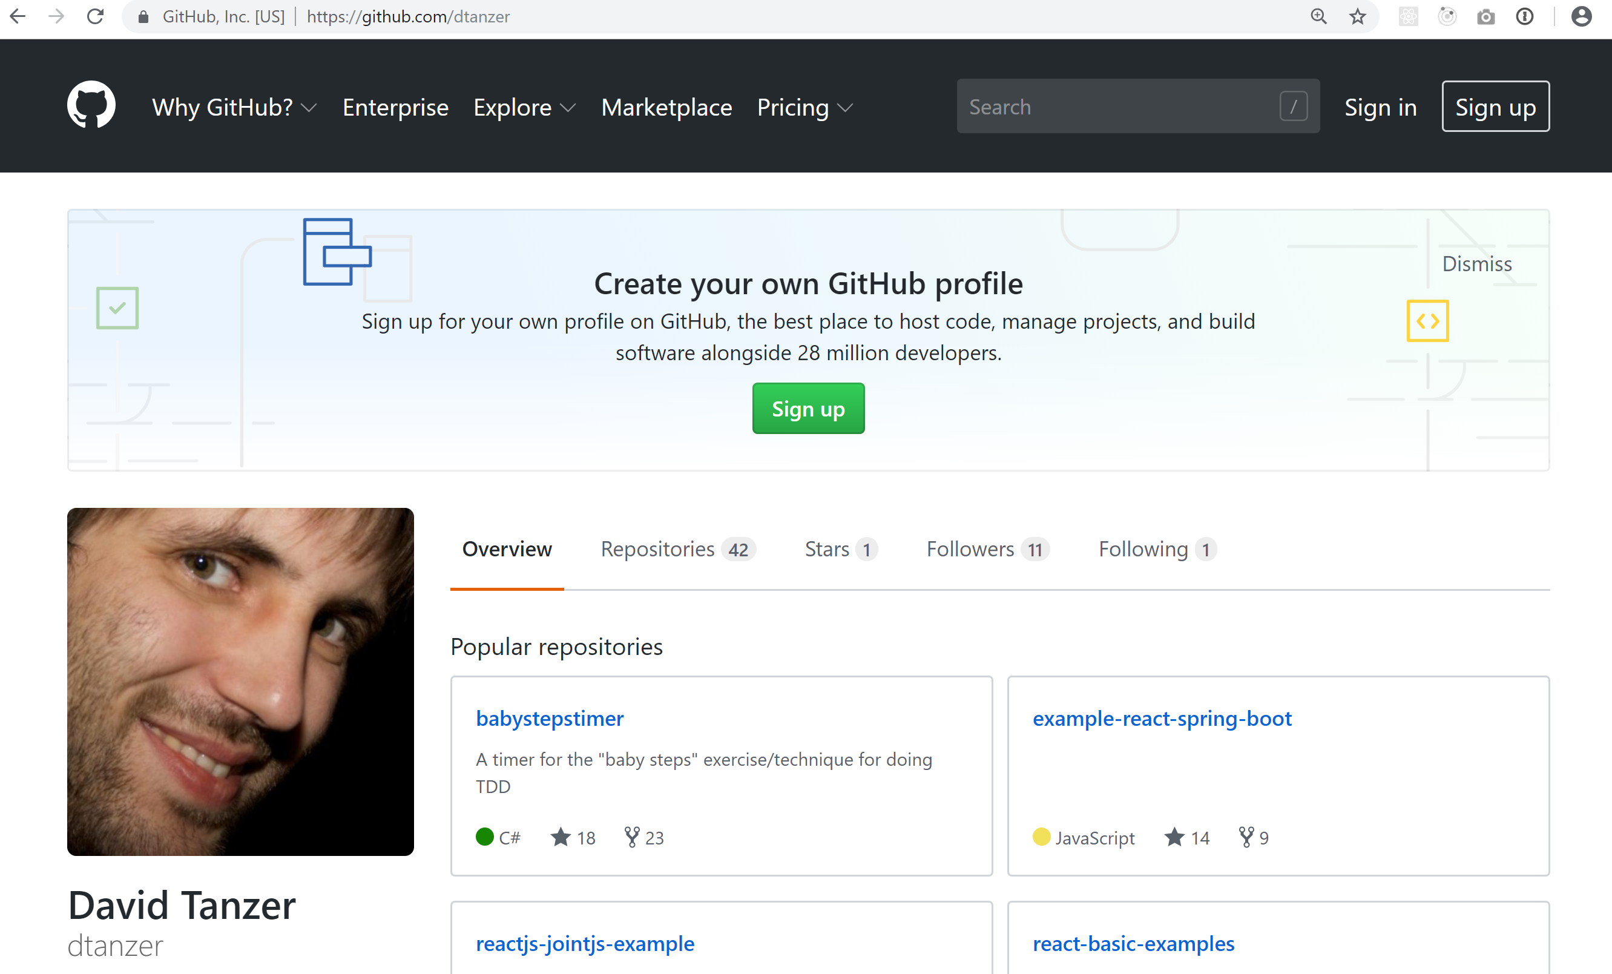
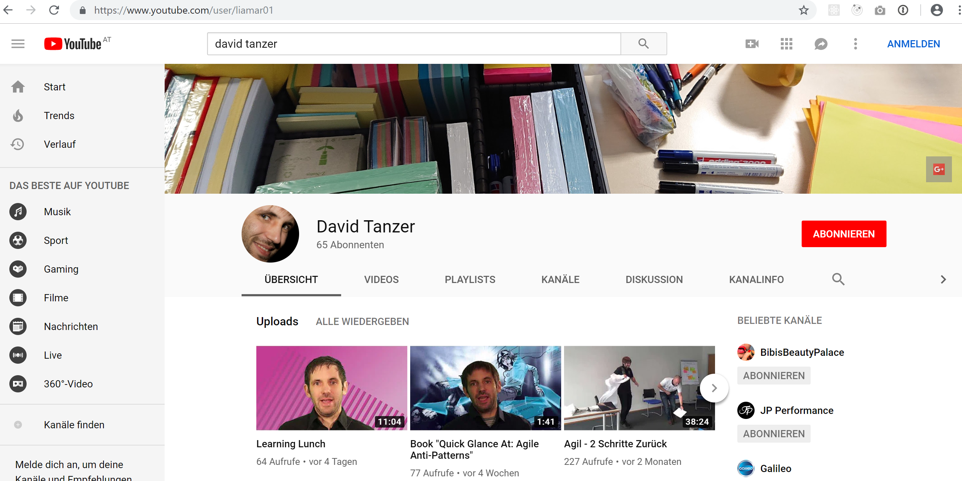
David Tanzer
@dtanzer
dtanzer
David Tanzer

Slide 8
